Slide 1
Smart Mining Helmet
Introduction to IoT Project Presentation
Done by: Team Internet Explorers

Slide 2
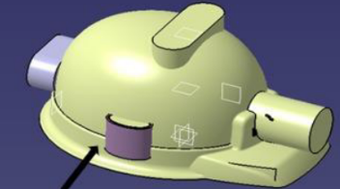
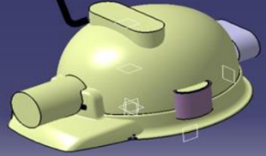
Introduction
Sample Installation Method
(with sensors on helmet)
Smart Mining Helmet – Original Objectives
Goals:
Monitor surrounding environment
Alert on potential head injury (use of notifications and buzzers)
Worker’s overall safety
Potential Deployment Design: Would be installed onto a mining helmet, crash collision sensor can be cushioned such that it gets triggered due to knocks on the top or back of the head

Slide 3
Hardware Components

Slide 4
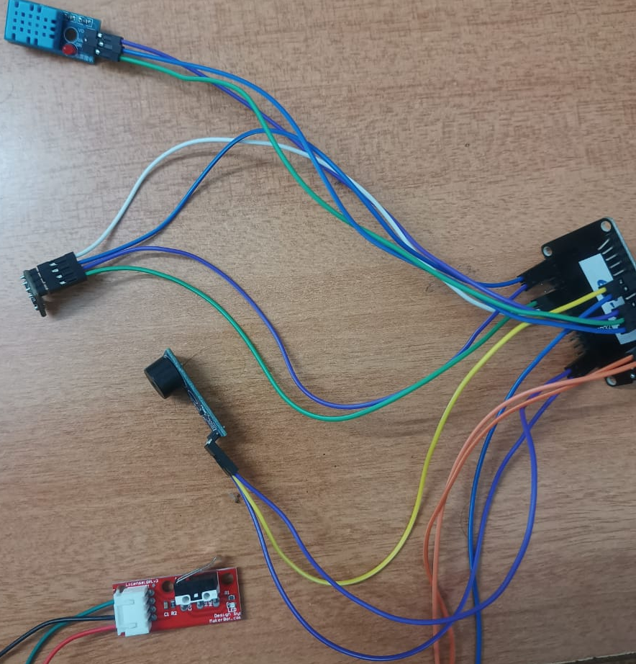
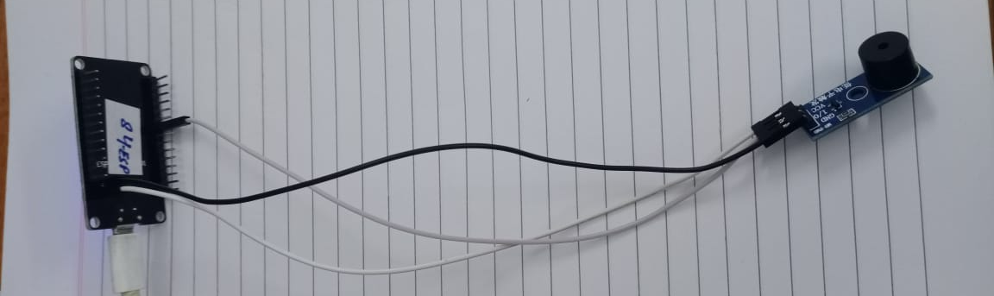
Components
2 ESP32s – 1 to operate buzzer at distant location
Connecting wires
DHT-11 (measuring temperature and humidity)
BMP280 (measuring pressure)
Impact switch crash collision sensor (switch mechanism on contact pressure)
2 buzzers – 1 for helmet, another which buzzes from a distance

Slide 5
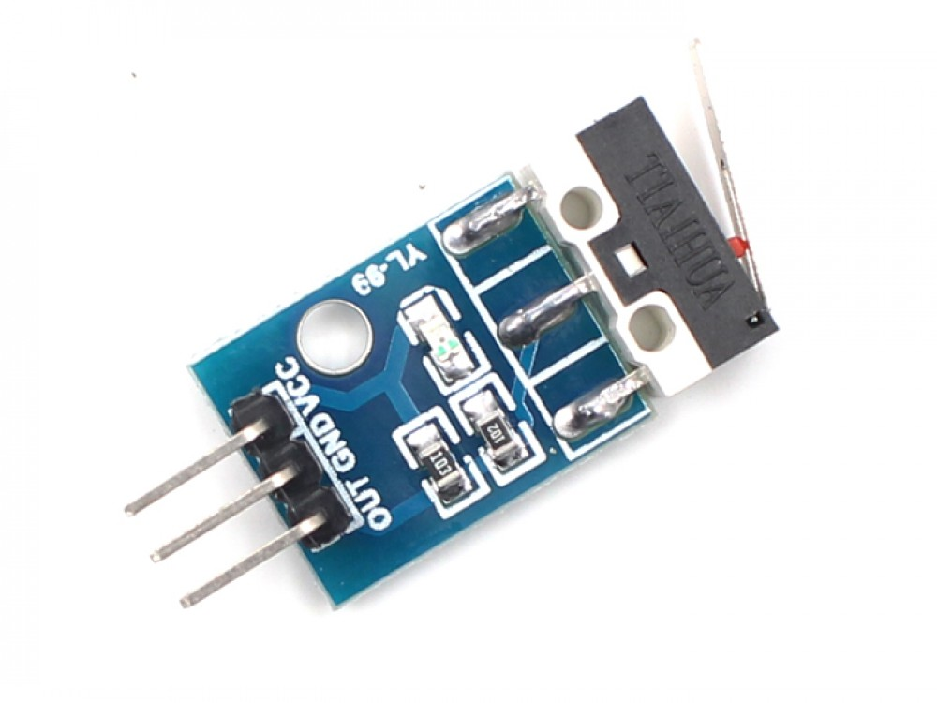
Impact Switch Crash Collision Sensor - Working
Simple switch mechanism
Based on on-off mechanism – gives output 0 for collision detection, 1 otherwise

Slide 6
Project Implementation

Slide 7
Basic Implementation
Reads temperature, humidity, air pressure, current status of collision sensor
Buzzer beeps if values go beyond pre-set thresholds, till values don’t return to normal
Accidental pressing of collision sensor can be reversed by putting pressure on sensor again
Crash Collision sensor can also be used as a panic alert system

Slide 8
Use of 2nd ESP32 and buzzer
Use of OM2M, ThingSpeak and Blynk
Data is fed into OM2M, then retrieved for setting buzzer status
Graphical depiction of longer-term data obtained on ThingSpeak
Notification and email sent using Blynk if crash collision sensor is triggered
Remote alert system
Buzzer will simultaneously sound along with the buzzer connected to ESP32 connected to sensors
2nd ESP32 will GET values from OM2M, similar to the main ESP32 and sound based on thresholds

Slide 9
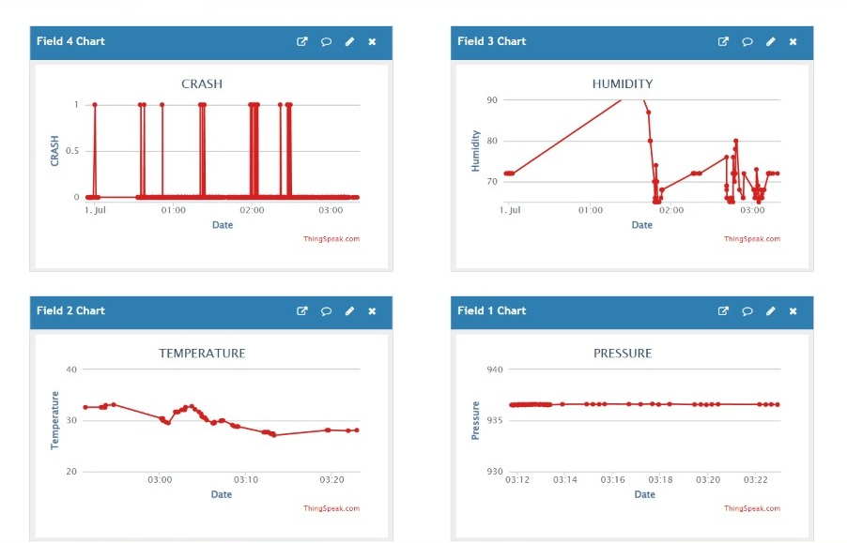
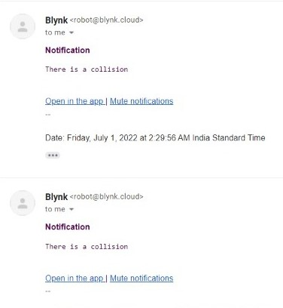
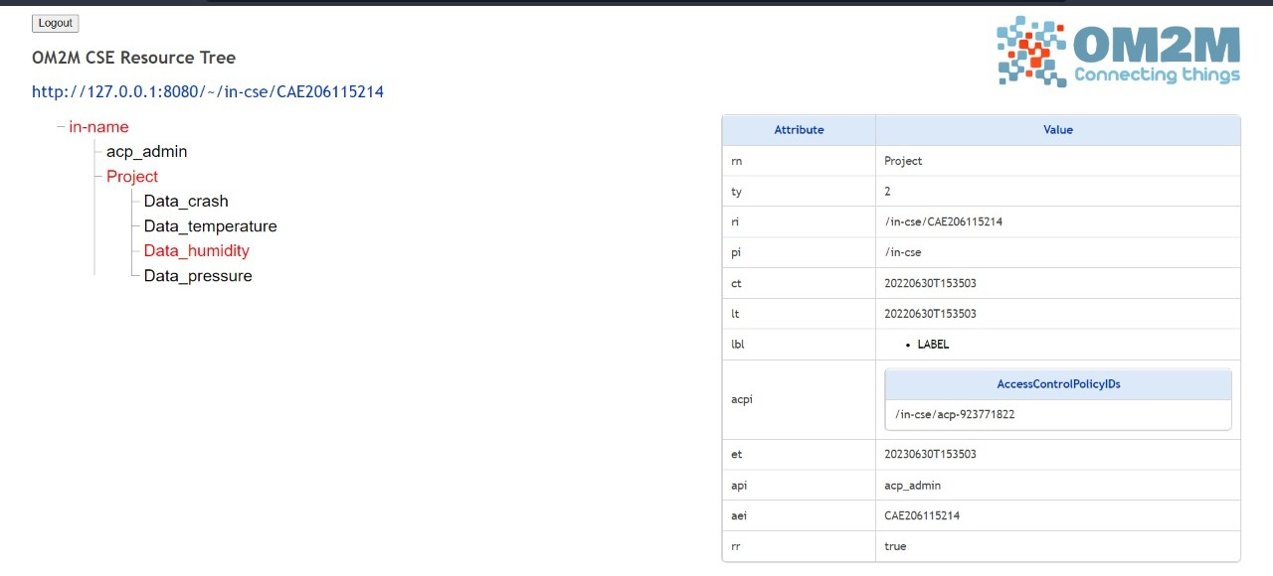

Slide 10
Overview of Code Logic
Start
Connect to Wi-Fi, MQTT broker
Not connected
Created individual functions for inserting to and retrieving data from OM2M, plotting data on ThingSpeak, sending email and notification for collision detection using Blynk
Using Wi-Fi to operate OM2M and ThingSpeak
Loop; pass data from sensors into OM2M and ThingSpeak
Retrieve last value posted on OM2M to alter buzzer status for both ESP32s
If any of the thresholds are crossed, goes into a while loop, buzzer does not stop beeping till threshold constraints are not met
Read values from sensors
Connected
Check Wi-Fi connection
POST values onto OM2M, Blynk and ThingSpeak
Cmp Thresholds & last reading on OM2M using GET
Ensure buzzer off
All lower
Any 1 higher
Turn on buzzer

Slide 11
Video Demonstration

Slide 12
Challenges
Original plan to use MQ2 gas sensor – changed due to safety reasons and potential issues in implementation
Cannot physically visit mines to deploy product – simulated conditions to obtain desired outputs and values
Conclusions
Achieved primary objectives of monitoring external conditions and potential injuries to head
Data from helmet can potentially even be used for purposes other than safety monitoring -- additional datapoints for measuring temperature, pressure, etc. in mine environments

Slide 13
Thank You!

